Slide 1
Windows Configuration Management with Puppet
Why let the Linux admins have all the fun?

Slide 2
Gene Liverman
SRE @ Puppet
Formerly SysAdmin @ University of West Georgia
Windows, Linux, Mac, & Solaris
Storage, Firewalls, Load Balancers, etc.

Slide 3
Agenda
Better together
Chocolatey
Patching
Modules
Packer

Slide 4
Better Together
(DSC, Hyper-V, SCCM, WMI) + Puppet

Slide 5
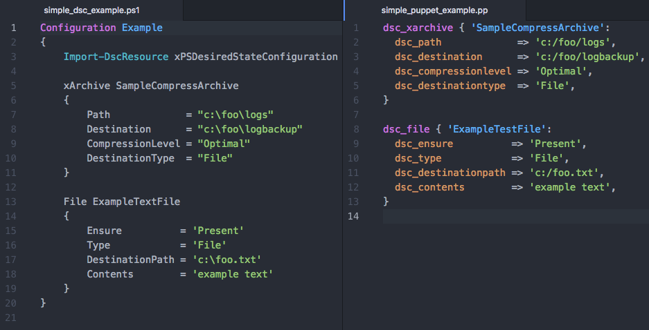
DSC in PowerShell vs DSC via Puppet
Write less code to do the same thing

Slide 6
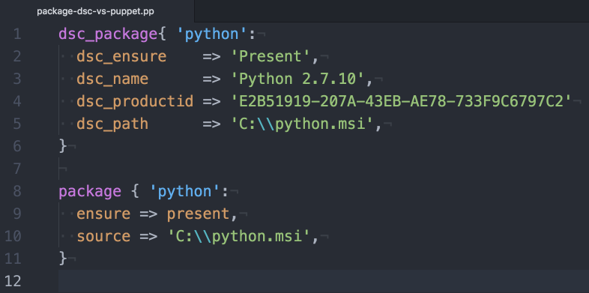
Migrate resources to Puppet
Get the same result fewer lines of code

Slide 7
Puppet + DSC
DSC doesn’t do everything Puppet does
No real reporting
No rebooting as needed
No package management
Doesn’t keep historical data on changes performed
DSC does cover things Puppet doesn’t
Hyper-V is one example

Slide 8

You'll likely run into a situation where either Puppet or DSC doesn't cover the entirety of the problem all by itself. Instead of trying to make one solution fit all, you can mix and match them.
Paraphrasing the “Managing Windows with Puppet Enterprise” white paper

Slide 9
Layering Puppet Enterprise on top of DSC
Gain rich management capabilities including:
Node classification
Status of nodes across your infrastructure
Global access control
Authentication can be via AD credentials
Tracking and reporting change
This simplifies compliance auditing

Slide 10
Puppet, DSC, & Hyper-V
xVHD manages VHDs in a Hyper-V host.
xVhdFile manages files or directories in a VHD.
xVMHost manages Hyper-V host settings.
xVMNetworkAdapter manages VMNetadapters attached to a Hyper-V virtual machine or the management OS.
xVMProcessor manages Hyper-V virtual machine processor options.
xVMSwitch manages virtual switches in a Hyper-V host.
The xHyper-V module

Slide 11
Puppet + WMI
Custom facts
Starting out with Puppet custom facts
https://glennsarti.github.io/blog/puppet-ruby-facts/
Integrate with existing SCCM
Query client configuration such as location
Module: thoward/sccm_application
Installs or uninstalls packages advertised by SCCM

Slide 12
Chocolatey
aka apt-get / yum for Windows

Slide 13
Package management for Windows
What is Chocolatey?
Public repo: chocolatey.org
Private repo: Chocolatey Server
Module: chocolatey/chocolatey_server
Notes:
Chocolatey is a Windows package manager that can be used to manage third-party and internal software and their dependencies

Slide 14
Common use cases for Chocolatey
FOSS Puppet agent
Monitoring & Backup agents
Log shipping
PowerShell / WMF, .Net, NodeJS
Browsers & plugins
Chrome & Firefox
Adobe, Flash, Java
Utilities such as Git, 7-Zip, & Notepad++

Slide 15
Patching
WSUS + strict change windows + Puppet

Slide 16
Patching scenario
Install & manage Chocolatey
Install NuGet package provider for PowerShell
Install PSWindowsUpdate PowerShell module
Define a maintenance window
Configure automated reboots during the maintenance window
Install PowerShell and WMF
Configure WSUS-related settings on the client
Apply all non-interactive updates

Slide 17
Demo Time: Code Sample
A Puppet manifest for patching Windows

Slide 18
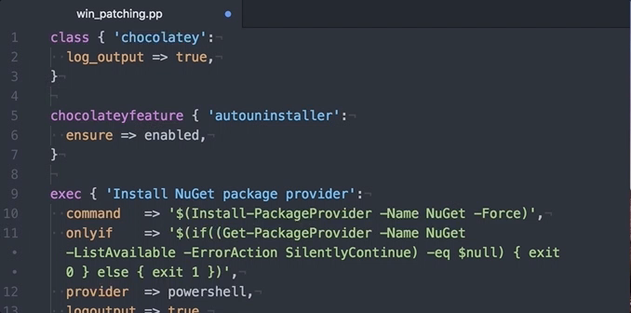
Code sample (video)

Slide 19
Modules
Common tasks made easier and repeatable

Slide 20
Modules pulled in by puppetlabs/windows
Vox Pupuli, voxpupuli.org
puppet/download_file
puppet/windows_env
puppet/windowsfeature
Puppet, puppet.com
puppetlabs/acl
puppetlabs/chocolatey
puppetlabs/dsc
puppetlabs/iis
puppetlabs/powershell
puppetlabs/reboot
puppetlabs/registry
puppetlabs/stdlib
puppetlabs/wsus_client

Slide 21
Modules for common Windows tasks
A sample of what’s on the Puppet Forge
Backups:
thespain/veeamagent (WIP)
FOSS Puppet:
theforeman/puppet
Logs:
genebean/nxlog
puppet/windows_eventlog
Monitoring:
genebean/zabbixagent
icinga/icinga2
puppet/nsclient
sensu/sensu
Others:
puppet/sslcertificate
puppet/windows_firewall
puppetlabs/azure
puppetlabs/aws

Slide 22
Packer
Templated virtual machines

Slide 23
Packer resources
Blogs:
http://www.hurryupandwait.io/blog/creating-windows-base-images-for-virtualbox-and-hyper-v-using-packer-boxstarter-and-vagrant
Templates:
https://github.com/puppetlabs/puppetlabs-packer
https://github.com/mwrock/packer-templates
Packer: https://www.packer.io

Slide 24
References and resources
Blog posts on Windows from Puppet:
https://puppet.com/blog-tags/powershell-dsc
https://puppet.com/blog-tags/windows
Blog post on custom facts: https://glennsarti.github.io/blog/puppet-ruby-facts/
Chocolatey: https://chocolatey.org
PowerShell xHyper-V: https://github.com/PowerShell/xHyper-V
Puppet Forge: https://forge.puppet.com
White paper:
https://puppet.com/resources/whitepaper/managing-windows-with-puppet-enterprise

Slide 25
What we talked about
DSC, WMI, SCCM
Package management with Chocolatey
Patching and rebooting during change windows
Managing common tasks with Puppet modules
Building images with Packer

Slide 26
Go have some fun automating your Windows configurations
Let Puppet do the repetitive things while you do play with new stuff

Slide 27
Gene Liverman
gene.liverman@puppet.com
genebean.github.io/talks
github.com/genebean
@technicalissues

